Slide 1
AVACADO PRICE ANALYSIS
Objective: Comparison of different forecasting techniques and automation of codes
Process: Automate feature & model selection on a multivariate time series data
Dataset: It is about Avocado Prices and volume consumption across different provinces in US from 4/1/2015 to 25/3/2018.Data is on a weekly basis and has several indicators specific to Quantity like bag-size and avocado variants . The data is collected from Kaggle as mentioned in the link https://www.kaggle.com/neuromusic/avocado-prices

Slide 2
PROJECT-OFF THE WORK
Data Scraping: For data augmentation the data is scrapped from https://power.larc.nasa.gov/ which had several agricultural indicators across each states like temperature , pressure, humidity and windspeed.
Assumptions: The production of these fruits might be affected due to one of the agricultural indicators which can indirectly have effect on the volume and price of Avocados although there is no proven evidence for it .Other indicators like CPI ,unemployment rate were considered as well as it would influence price indirectly
Dependent and Independent variables : Total volume is the dependent variable and all other variables are regressed on it

Slide 3
SAMPLE SIZE AND DATA SET INFO
TRAINING SIZE-102
TEST SIZE-40
OOB TRAIN SIZE-54
TEST SIZE-23
RANDOM STATE=1
TEST SIZE=30%
OOB DATASET-2383 records
TRAIN-TEST DATASET-13500 records
TOTAL FEATURES-130

Slide 4

CLUSTERS & REASONS FOR CHOOSING IT BASED ON REGIONS
There are around 47 regions in the dataset and the data can be segmented to around 12-14 clusters based on the dispersion . Empirical rule was considered to group observations within mean+/-3sd making underlying assumption that the Total Sales is normally distributed.
Confirmation test for normality-KS test

Slide 5
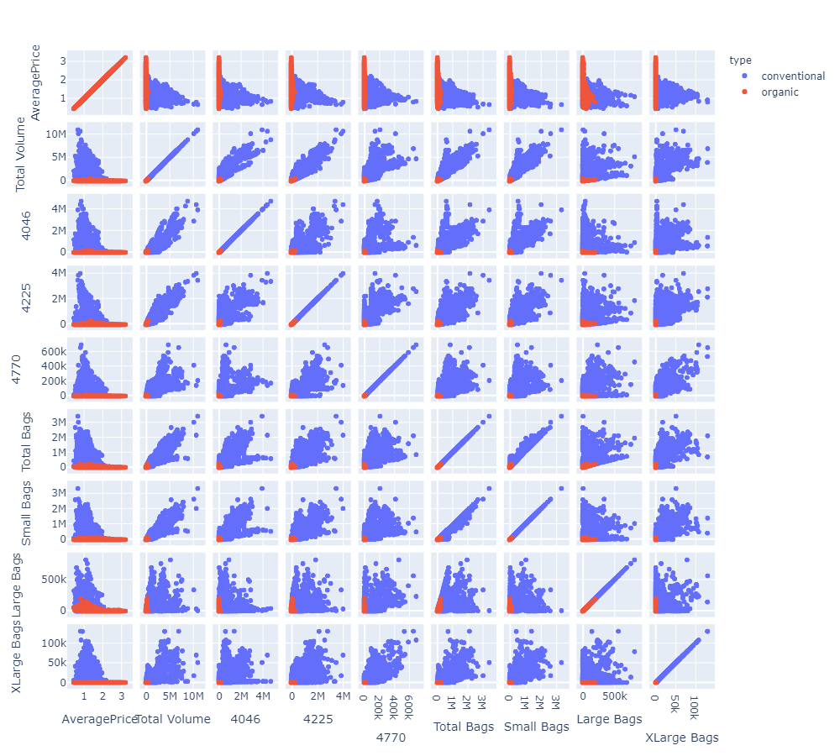
EXPLORATORY DATA ANALYSIS
Total volume is highly correlated with Bags variants and type of Avocados
Average price shows a negative correlation

Slide 6
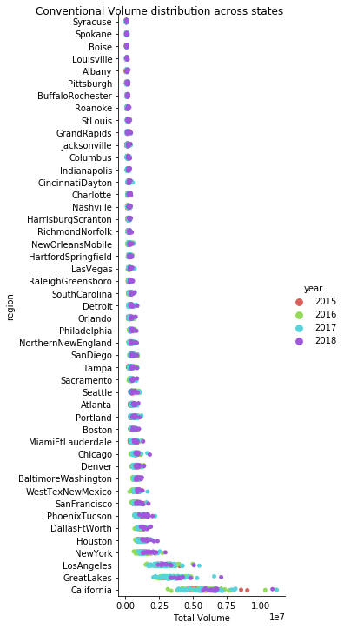
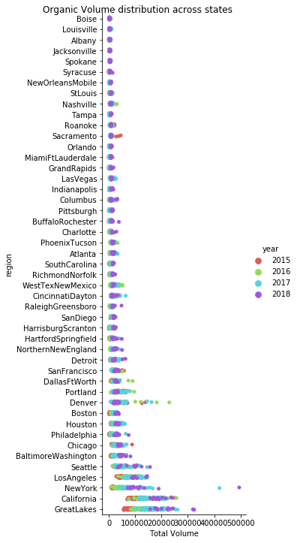
FINDINGS
There is clearly a pattern of sales in different states, Some states are meagre consumers and few consume at a high level and few are normal volume consumers . Conventional and Organic Avocado sales differs a lot and hence they need to be treated separately for clustering analysis

Slide 7
DATA DISPERSION ACROSS REGIONS(SAMPLE:CONVENTIONAL)
 | mean | std | Q1 | median | Q3 | meanplus3sd | meanminus3sd | region
0 | 60410.66856 | 14915.220079 | 48655.18 | 60421.42 | 70174.79 | 105156.328796 | 15665.008324 | Syracuse
1 | 82636.97184 | 19372.496463 | 66246.30 | 80904.19 | 95143.57 | 140754.461230 | 24519.482450 | Boise
4 | 91033.02608 | 28615.998330 | 70253.30 | 92774.61 | 108264.90 | 176881.021070 | 5185.031090 | Albany
2 | 90358.85032 | 22401.083300 | 74748.35 | 87249.43 | 101869.42 | 157562.100219 | 23155.600421 | Spokane
3 | 90514.19568 | 19650.740673 | 76543.82 | 88102.95 | 101162.98 | 149466.417699 | 31561.973661 | Louisville

Slide 8
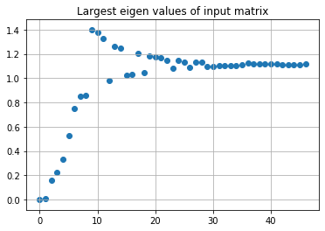
SPECTRAL CLUSTERING AND EIGEN DECOMPOSITION-CONVENTIONAL
Spectral clustering was used to find clusters because it separates noise in the data better than K-means or Mean shift algorithms
Eigen Decomposition was done to select number of clusters . The data needed normalization for spectral clustering and PCA was done to reduce dimensions
Cluster chosen was 13 for conventional
Source of study: https://github.com/ciortanmadalina/high_noise_clustering/blob/master/

Slide 9
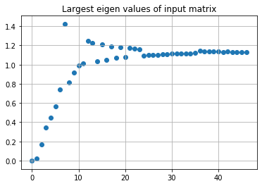
SPECTRAL CLUSTERING AND EIGEN DECOMPOSITION-ORGANIC
Cluster chosen was 12 for Organic
Source of study: https://github.com/ciortanmadalina/high_noise_clustering/blob/master/

Slide 10
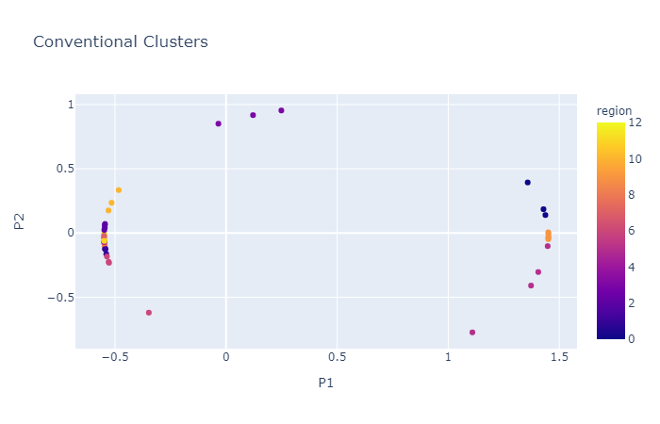
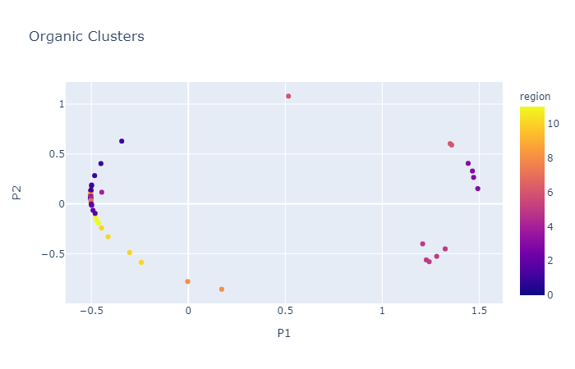
CLUSTERS ACROSS PC1 AND PC2

Slide 11
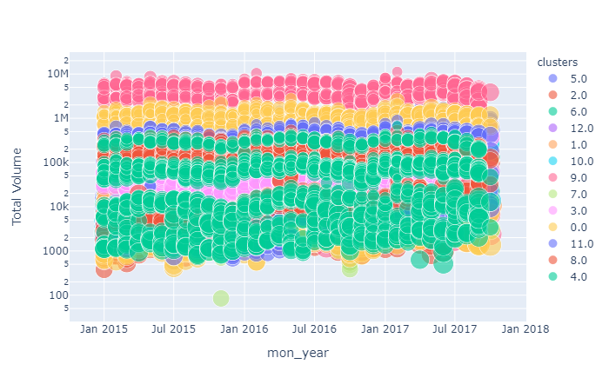
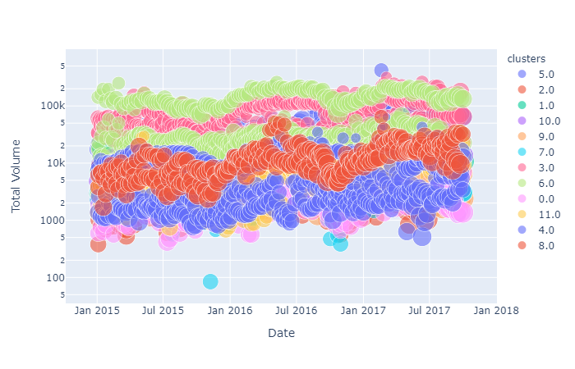
CLUSTER DISTRIBUTION
CONVENTIONAL
ORGANIC

Slide 12
MODEL CONSIDERATIONS
The following three models were considered for modelling framework function
STEPWISE FORWARD SELECTION FOR FEATURE SELECTION AND OLS
LASSO REGRESSION
DECISION TREE REGRESSION
Outliers were treated and imputed with 95th percentile & 0.05th percentile

Slide 13
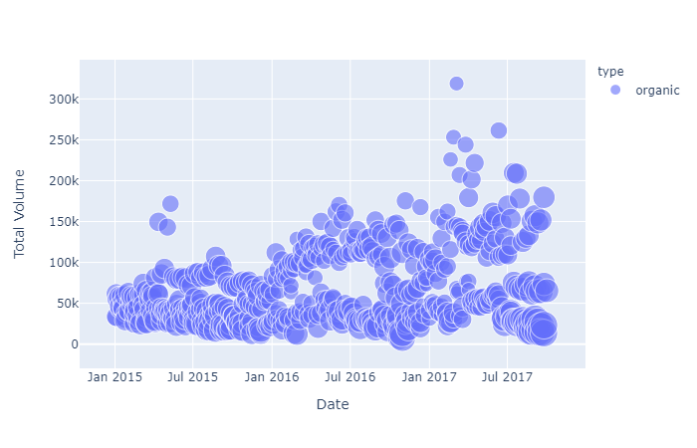
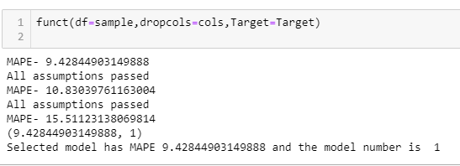
SAMPLE DATA TO THE MODELING FRAMEWORK & MODEL OUTPUT(CLUSTER=3,TYPE=ORGANIC)

Slide 14
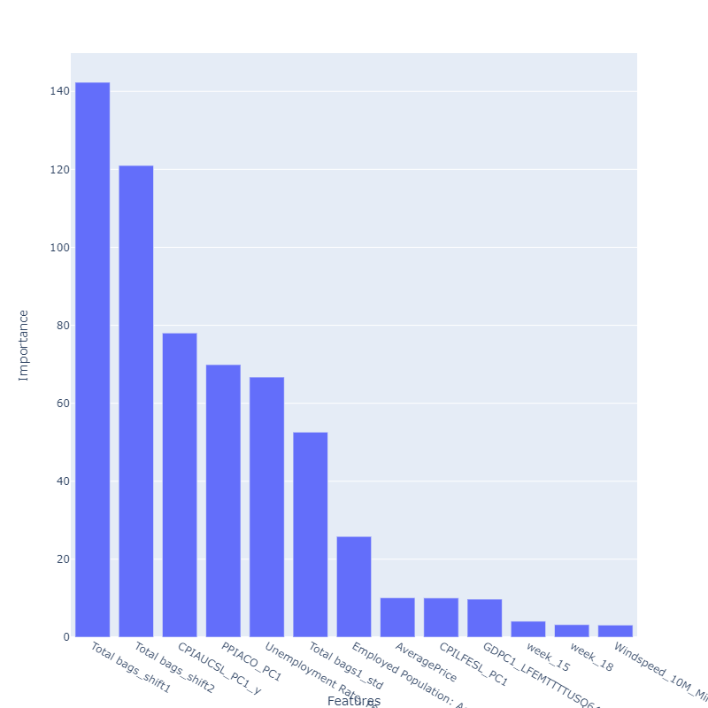
FEATURE IMPORTANCE USING f_regression(scikit learn-Univariate linear regression tests)

Slide 15
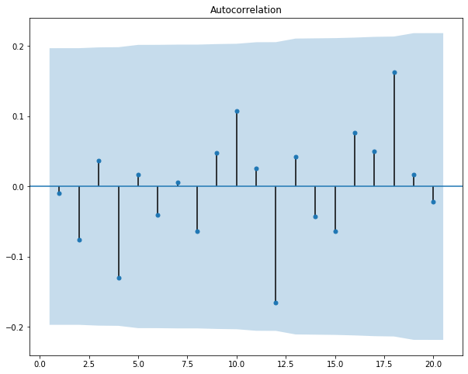
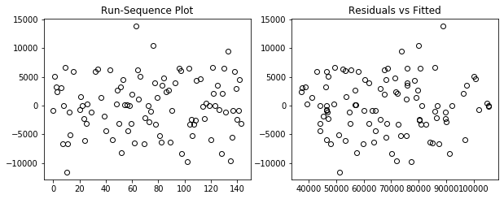
MODEL DIAGNOSTICS
Autocorrelation of residuals
Residual plot
Breusch Pagan statistic

Slide 16
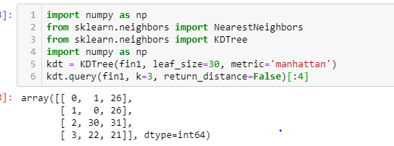
FINDING SIMILAR CLUSTERS IN OOB SAMPLE USING KDTREE UNSUPERVISED ALGORITHM(A VARIANT OF KNN)
 | mean | std | Q1 | median | Q3 | meanplus3d | meanminus3d | region
26 | 14131.031600 | 2984.035794 | 11837.2000 | 13514.360 | 16925.6200 | 23083.138983 | 5178.924217 | PhoenixTucson
30 | 14933.136154 | 2933.199060 | 13738.6875 | 15416.795 | 16693.7475 | 23732.733333 | 6133.538975 | WestTexNewMexico
22 | 11837.371923 | 4161.317920 | 9588.5100 | 11407.285 | 12320.9175 | 24321.325684 | -646.581838 | Charlotte
WITH NEW DATASET THE SEGMENTS FORMED BY USING SPECTRAL CLUSTERING WOULD BE DIFFERENT AND IT IS JUST A RANDOM CLUSTER NUMBER ASSIGNED.HENCE KDTREE ALGORITHM WAS USED TO FIND NEAREST CLUSTERS AFTER REMOVING REGION

Slide 17
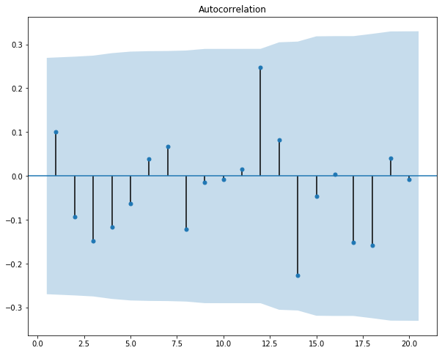
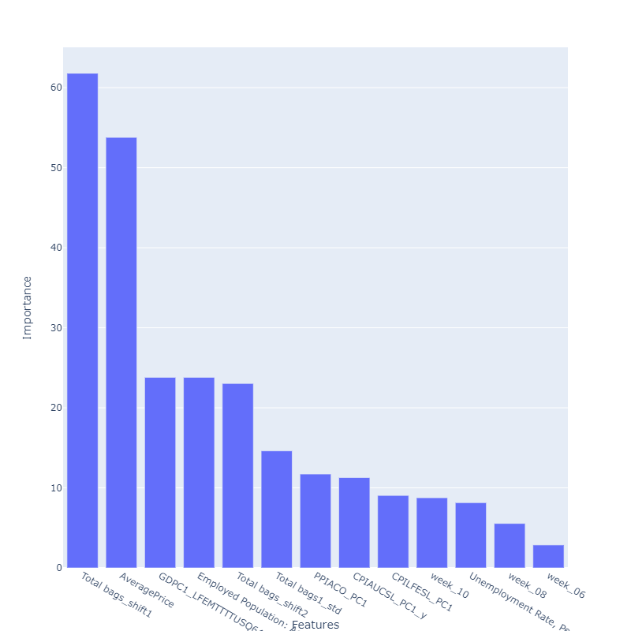
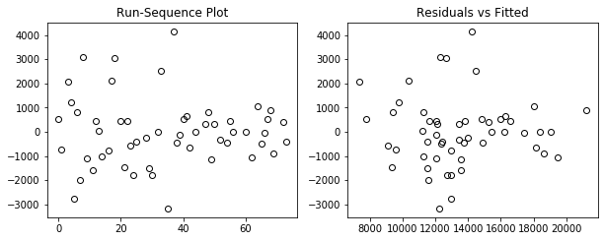
OOB DIAGNOSTICS & FEATURE IMPORTANCE
Diagnostics
Feature Importance
Breusch Pagan statistic

Slide 18
MODEL ACCURACY & FEATURES USED
TRAIN MAPE-7.8998
TEST MAPE-9.428
TRAIN OOB MAPE-8.295
TEST OOB MAPE-16.46379
'Total bags_shift1', 'AveragePrice', 'Windspeed_10M_Minsquare', 'Unemployment Rate, Percent, Monthly, Seasonally Adjusted', 'Total bags1_std', 'PPIACO_PC1', 'week_52', 'week_14', 'Total bags.1_max % change', 'GDPC1_LFEMTTTTUSQ647S', 'week_28', 'CPIAUCSL_PC1_y', 'CPILFESL_PC1', 'Employed Population: Aged 15 and Over: All Persons for the United States, Percent Change from Year Ago, Quarterly, Seasonally Adjusted', 'Total bags_shift2', 'week_02', 'week_03', 'week_04', 'week_05', 'week_06', 'week_07', 'week_08', 'week_09', 'week_10', 'week_11', 'week_12', 'week_13', 'week_15', 'week_16', 'week_17', 'week_18', 'week_19', 'week_20', 'week_21', 'week_22', 'week_23', 'week_24', 'week_25', 'week_26’
Model performed poorly with Test OOB samples . This could probably be because of not enough examples in the OOB training set as well as the clustering process of OOB

Slide 19
MODELLING PROCESS
SPLIT DATAFRAME INTO TWO PARTS ONE FOR MODEL BUILDING AND ONE FOR OOB
PERFORM EDA & PROFILE CUSTOMERS BASED ON THE DISPERSION ACROSS REGIONS AND TYPE OF FRUITS
AGGREGATE DATA & ADD EXTERNAL INDICATORS AND MAKE NECESSARY TRANSFORMATIONS,ENCODING DUMMY VARIABLES
AUTOMATOR FUNCTION TAKES INPUT AND SPLITS DATA INTO TRAIN,TEST AND GRIDSEARCH CV and RETURNS OUTPUT BASED ON MAPE and ACCURACY METRICS
PLOT DIAGNOSTICS TO EVALUATE BEST MODEL AND CHECK MODEL ASSUMPTIONS
GET THE DISPERSION BASED ON REGIONS ,TYPE AND COMPARE IT TO CLUSTERS ALREADY USED IN THE MODEL & USE UNSUPERVISED KNN TO FIND THE CLOSE CLUSTER POINTS AND REPEAT STEPS 3-5

Slide 20
HOW MODEL CAN BE USED AND DISADVANTAGES
This model is a proactive model, since we would be knowing the total bags sold for the prior weeks('Total bags_shift1’, 'Total bags_shift2’) and it is a significant predictor in both OOB and the modelling dataset. Those can be used to predict the total sales for the present week
Model is based on the behaviour of total sales across regions and clusters were formed for two types of avocados serving US customers and it can’t do predictions region based since the model would not include regional aspect but it would bucket the region based on consumption(total sales)

